Slide 1
Analysis and Visualization of Racial Profile Prohibition Traffic Data
Presented By
Jyoti Pati
Krishna Marvaniya
Ravi Bhadana

Slide 2
Table of content
SDLC
Dataset specifications
Tools Used
Machine Learning Algorithm
Visualization
Hive Queries

Slide 3
What is Our Project
This is the first analysis since changes to the Alvin W. Penn Act went into effect in October 2013
Steps taken by the IMRP (Institute for Regional and Municipal Policy) as part of the Connecticut Racial Profiling Prohibition Project
"The data indicates that Connecticut is well positioned to lead the nation in addressing the issue of racial profiling and increasing trust between the public and law enforcement.“
Our Motivation for choosing this dataset - #OscarsSoWhite in a country made of immigrants by and large

Slide 4
System Development life Cycle
Planning
Defined Scope
Analysis
Gathered data from Data.Gov
Design
Gathered required softwares such as Microsoft Azure HDInsight Cluster, Azure Management studio, Power BI, Tableau
Testing
Requirement Gathering
Time Estimation
Created Tables
Implementation
Developed Queries
Analysis made on the created Tables using graph and Map

Slide 5
Dataset Specifications
Dataset url: https://catalog.data.gov/dataset/racial-profiling-prohibition-project-traffic-stop-data
Dataset size: 175MB
Specification of experimental equipment:
Number Of Nodes : 4 (Worker node:A7 & Head Node:A3)
Memory Size: 605GB(Worker node) & 285GB(Head node)
CPU/core speed: 56GB(Worker node) & 7GB(Head node)
GitHub URL:
https://github.com/Jyopa/CIS520_Project

Slide 6
Tools Used
Microsoft Azure HDInsight Cluster
Azure Management Studio
Microsoft Excel
Tableau
Power BI

Slide 7
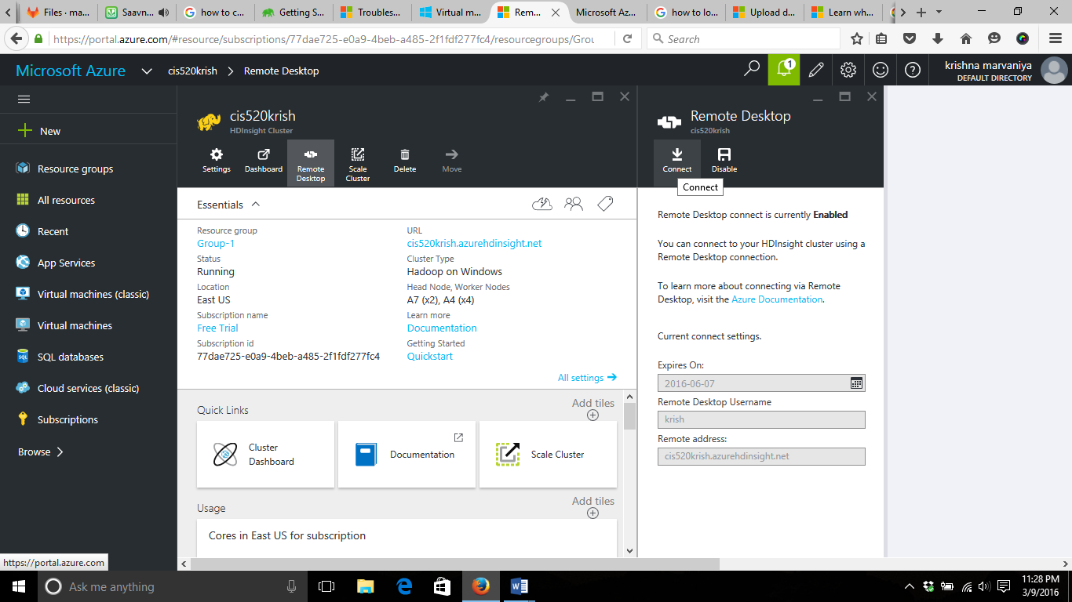
Creating Hdinsight Cluster

Slide 8
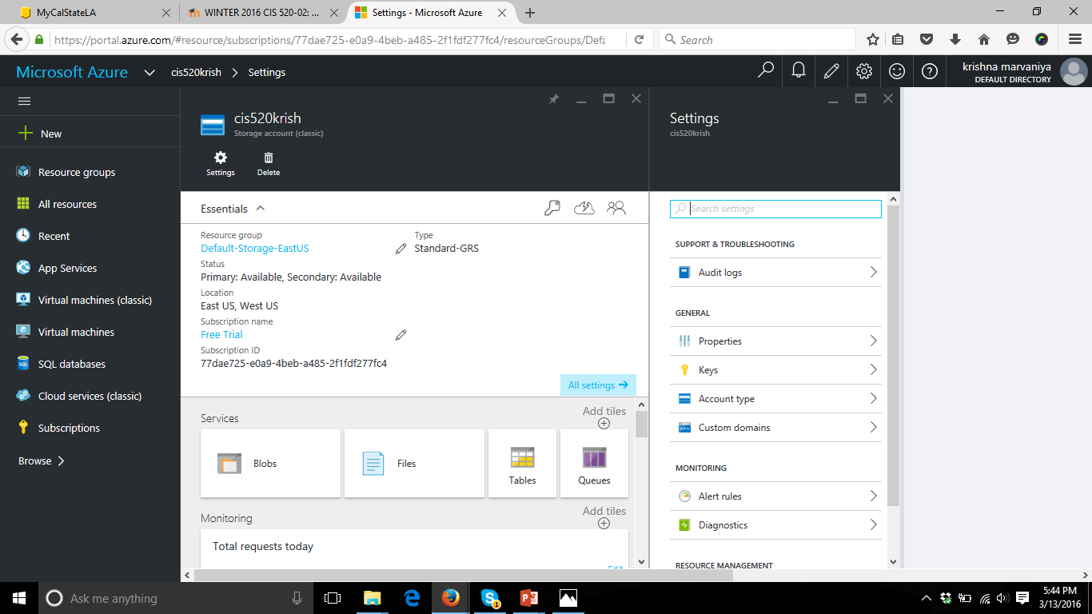
Creating Storage Account

Slide 9
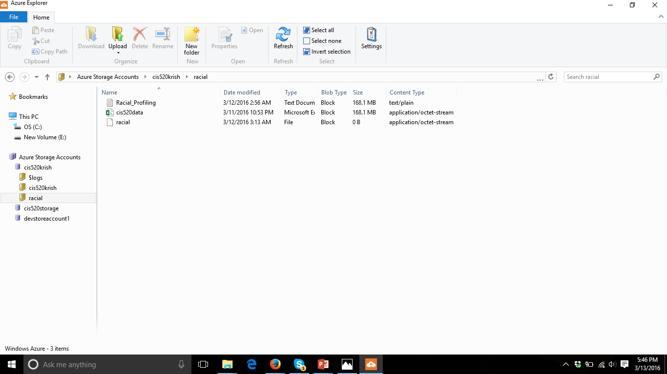
Uploading data using Azure Management Studio

Slide 10
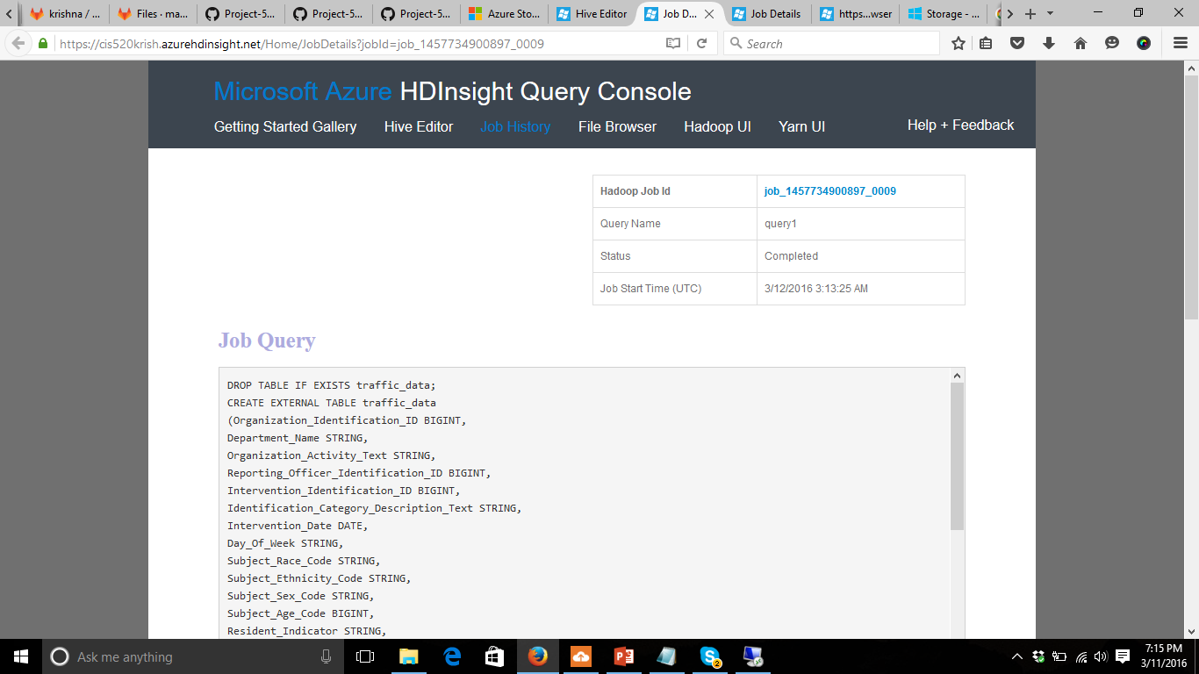
Run Hive Query in HDinsight Query Console

Slide 11
Algorithms
What is K-Means Clustering
High intra cluster similarity
Low inter cluster similarity
Finding natural groupings among objects
Population – Reporting Officer
Attributes – Intervention Disposition Code, Subject Race Code
Intervention Disposition Code ->
Verbal Warning, NA, no disposition = 0
Written Warning, Fine = 1
Subject Race Code -> White = 0 and Non-white = 1
K = 4, Iterations = 3

Slide 12
Algorithms
Result
Meaning | Cluster Number | Count of Reporting officers
Not tending to racial bias, Harsh | 1 | 3461
Tending towards racial bias, Harsh | 2 | 392
Not tending to racial bias, not harsh | 3 | 1891
Tending towards racial bias, Harsh | 4 | 221
For the detail working of K-Means algorithm, please refer to “K Means clustering Euclidian Distance.xlsx”

Slide 13
VISUALIZATION

Slide 14
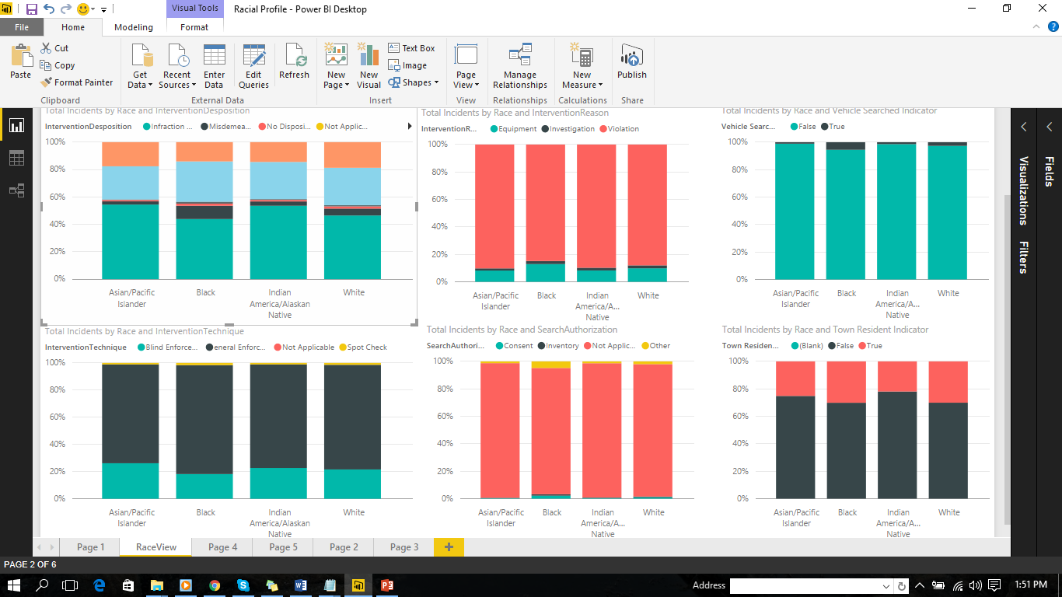
Algorithms

Slide 15
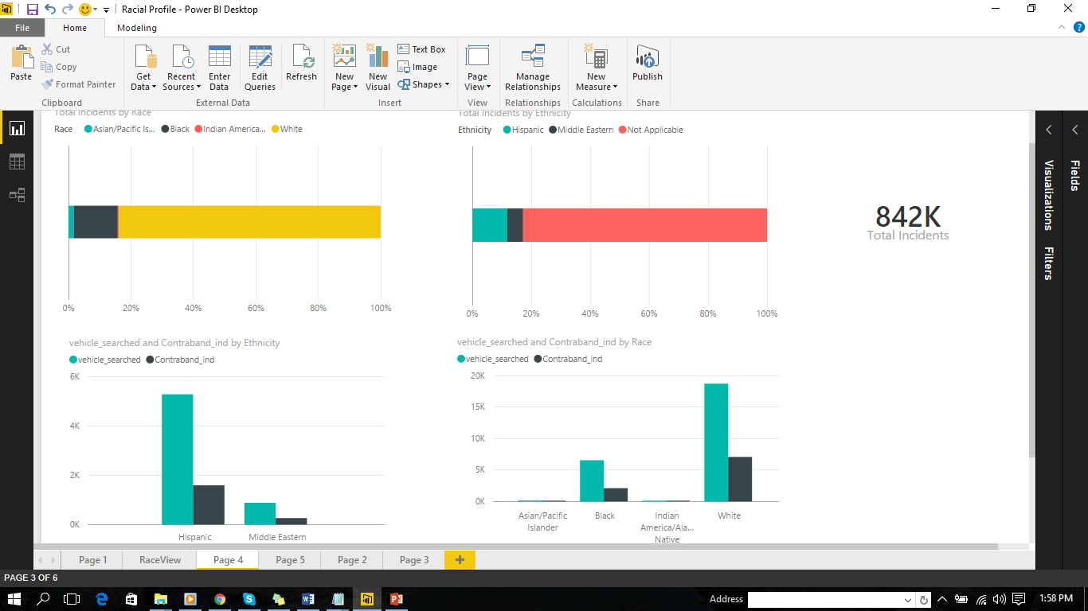
Algorithms

Slide 16
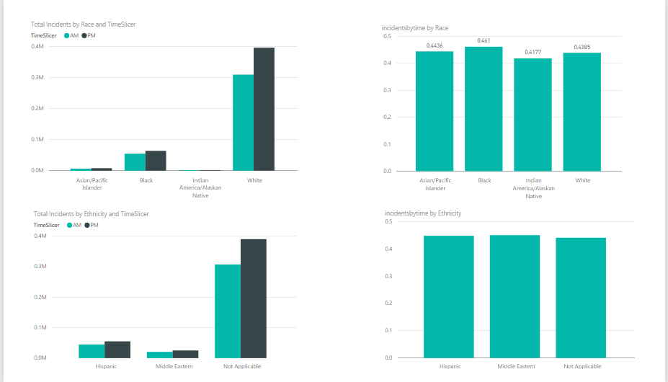
Algorithms

Slide 17
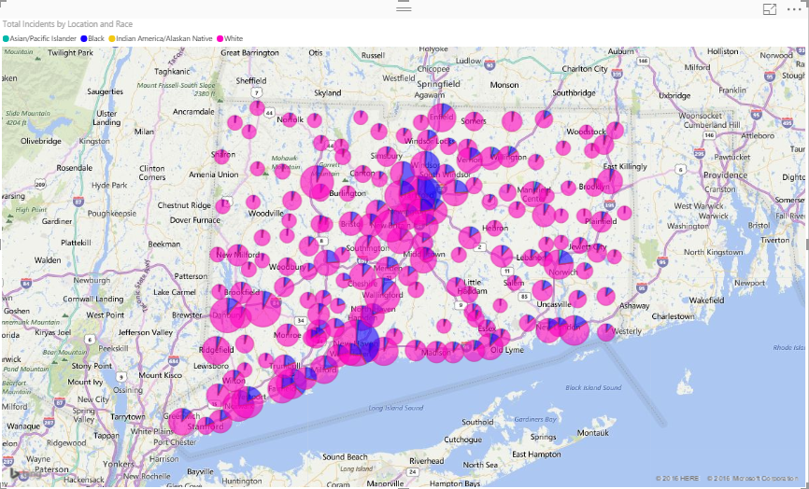
Total Incidents by Location and Race
CREATE TABLE Incident AS
Select Incident_Location_Name , Subject_Race_Code from traffic_data

Slide 18
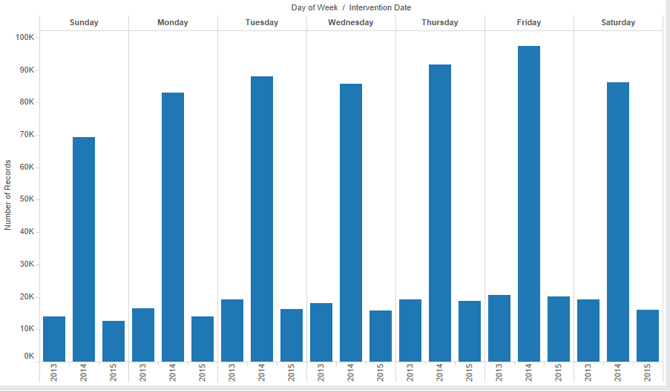
Days of the week/year
CREATE TABLE days AS
Select Day_Of_Week from traffic_data;

Slide 19
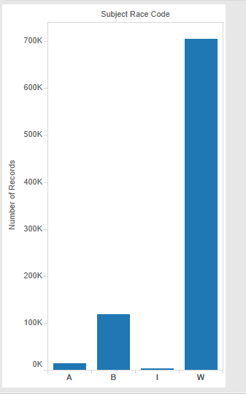
Subject Race Code
CREATE TABLE Race AS
Select Subject_Race_Code from traffic_data;
Officer perception of race: W - White B - Black I - Indian America/Alaskan Native A- Asian/Pacific Islander

Slide 20
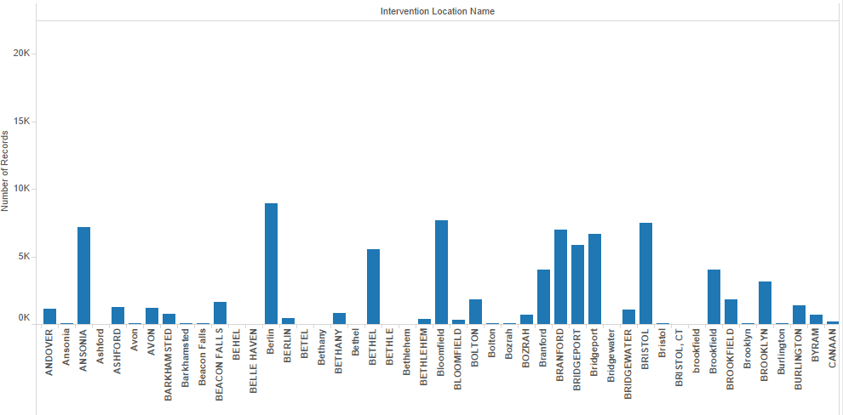
Intervention Location Name
CREATE TABLE location AS
Select Intervention_Location_Name from traffic_data;

Slide 21
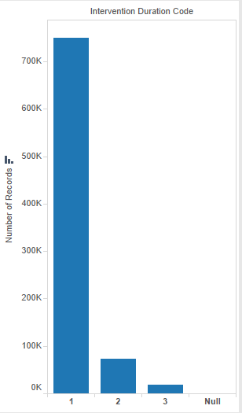
Intervention Duration Code
CREATE TABLE duration AS
Select Intervention_Duration_Code from traffic_data;
Duration of Stop: 1= 15 minutes or less 2= 16 to 30 minutes 3 = Greater than 30 minutes

Slide 22
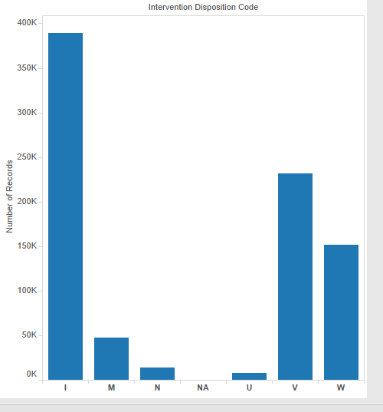
Intervention Disposition Code
CREATE TABLE disposition AS
Select Intervention_Disposition_Code from traffic_data;
Result of the stop: Uniform Arrest Repot: U Misdemeanor Summons: M Infraction Ticket: I Written Warning: W Verbal Warning: V No Disposition: N

Slide 23
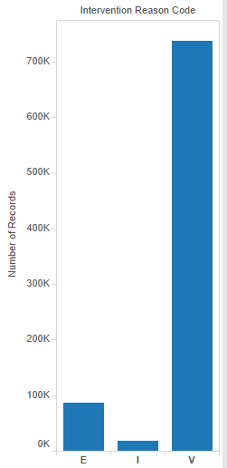
Intervention Reason Code
CREATE TABLE reason AS
Select Intervention_Reason_Code from traffic_data;
Nature of the Stop: Investigation: I Violation: V Equipment: E

Slide 24
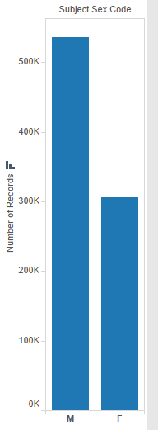
Subject Sex Code
CREATE TABLE Sex_code AS
Select Subject_Sex_Code from traffic_data;
Male: M Female: F

Slide 25
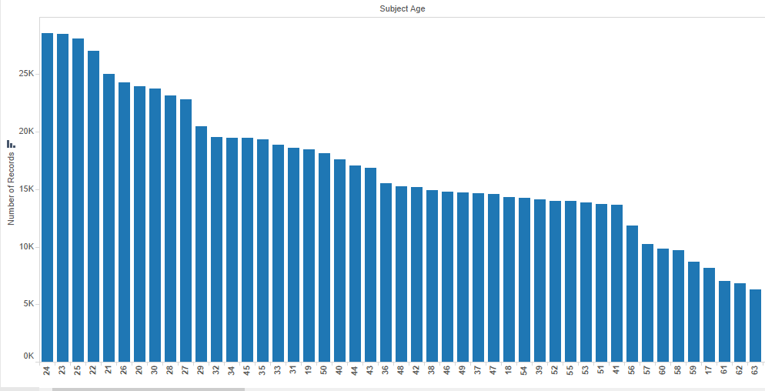
Subject Age
CREATE TABLE Age AS
Select Subject_Age from traffic_data;

